Slide 1
Office 365 for Education
Scott Robinson
Enterprise Solutions Architect
Insight
Scott.Robinson@insight.com

Slide 2
Office 365

Slide 3
Our complex, rapidly changing world
50% of existing jobs will be lost to automation
30-40% future jobs will require higher cognitive skills
42% of employers feel new graduates are adequately prepared

Slide 4
Empowering educators
Student-centric
More time for teaching
Communities of practice

Slide 5
Enabling a student-centric approach
Modern classroom tools
Collaborative experiences
Deeper understanding

Slide 6
More time for teaching
Meet student needs at scale
Deliver tailored lessons
Provide personalized feedback

Slide 7
Creating Communities
Connect with peers
Improve instruction
Share resources and ideas

Slide 8
Empowering students at Fresno Unified School District

Slide 9
Resources
https://education.microsoft.com/
https://www.microsoft.com/en-us/education
https://www.microsoft.com/en-us/education/educators/default.aspx
https://www.youtube.com/user/Microsoftedu

Slide 10
Microsoft Teams

Slide 11
Microsoft Teams
The hub for teamwork in Office 365 Education
Manage your most efficient class workflow
Save time and simplify the everyday logistics to focus on what truly matters– educating.
Engage the voice within every student
Empower students while helping them develop the skills they’ll need to be successful.
Connect in one hub for the entire school
Streamline school communication and collaboration by keeping all your teams in just one place.

Slide 13
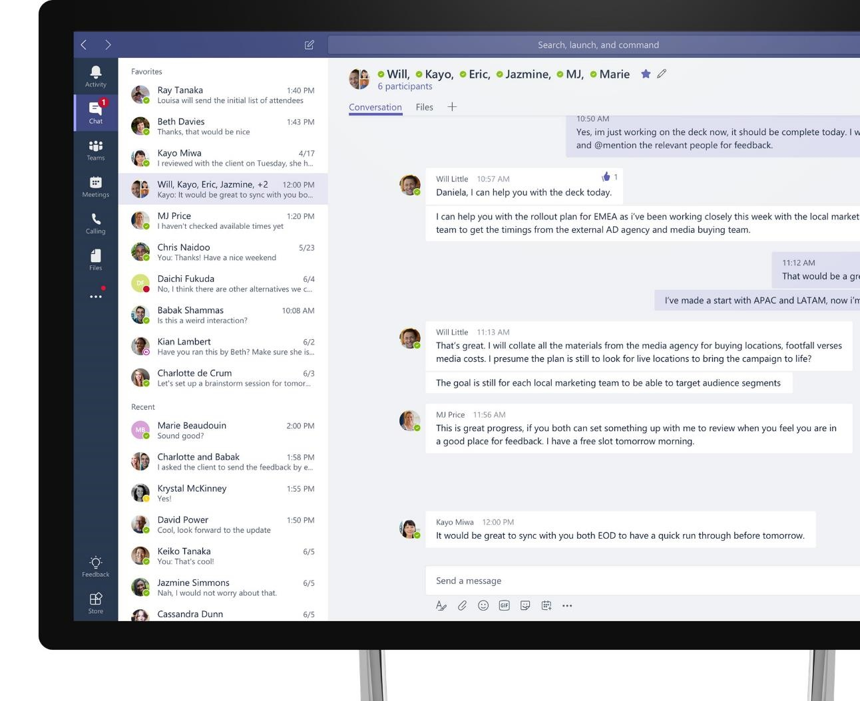
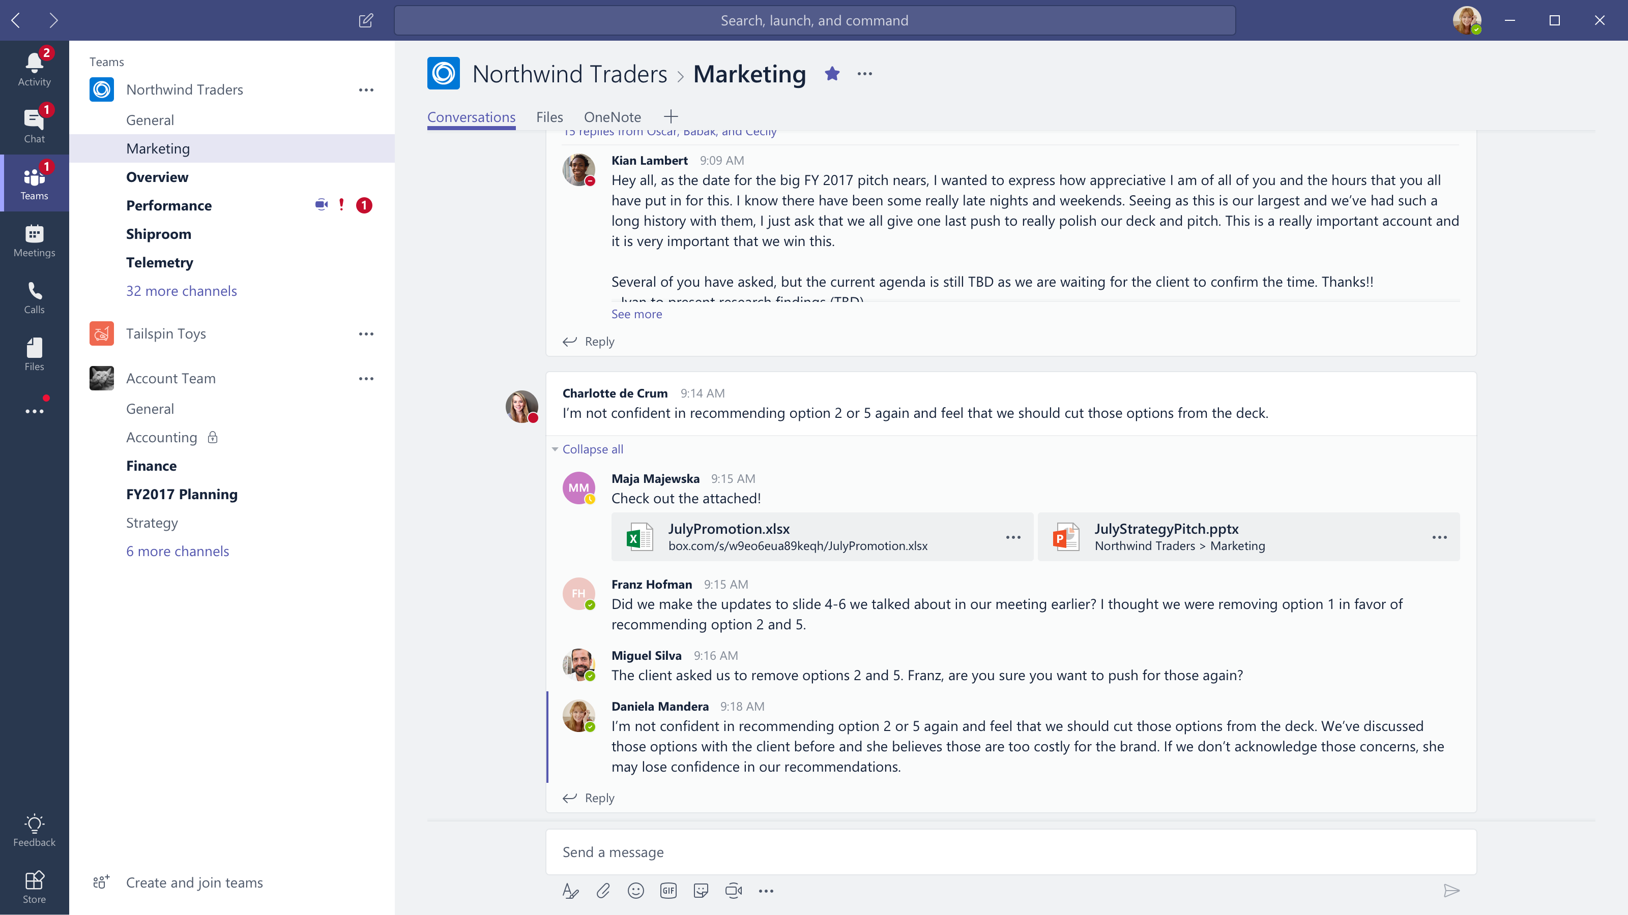
Microsoft Teams The hub for teamwork in Office 365
Communicate
through chat, meetings & calls
Collaborate
with deeply integrated Office 365 apps
Customize & extend
with 3rd party apps, processes, and devices
Work with confidence
enterprise level security, compliance, and manageability

Slide 14
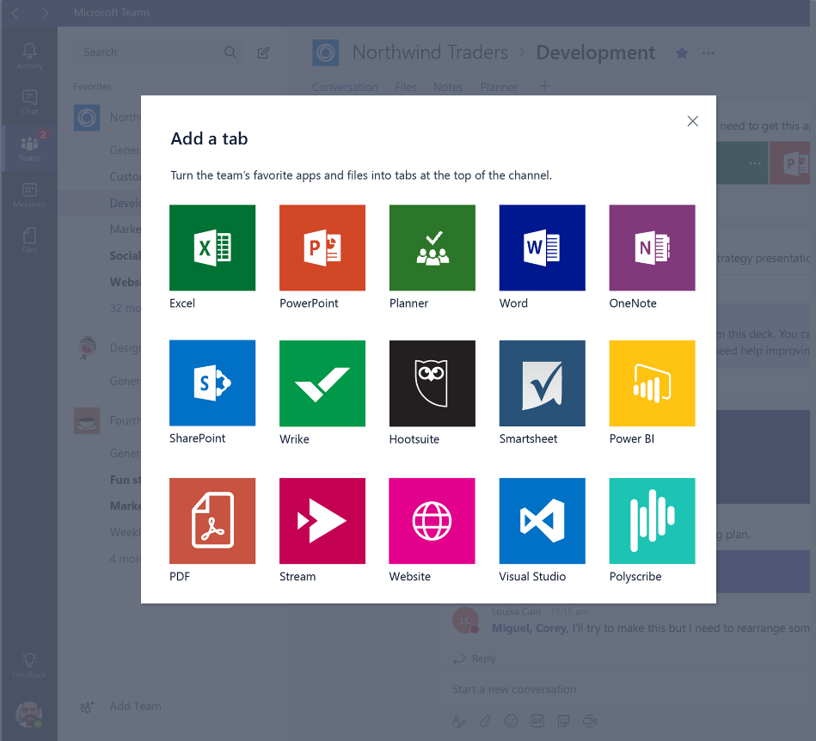
Designed for education
Create collaborative classrooms that save teachers time and better engage students in modern learning
Connect educators in professional learning communities to improve teaching skills with built-in PLC Notebooks
Streamline staff communication on school-wide initiatives using custom Staff Notebooks
Come together in a team for any team or project, like student groups or planning events

Slide 15
Enterprise security and compliance
Get the enterprise-level security and compliance features you expect from Office 365
Served from our global hyper-scale cloud, including ability for local data residency
Compliance leadership with EUMC, HIPAA & more
Built-in information protection with eDiscovery and audit
Multi-factor authentication and secure guest access
PSTN connectivity in Office 365 with advanced call management

Slide 16
Demo

Slide 17
New Experiences

Slide 18
Apps come from different publishers
1st Party Apps
3rd Party Apps
Custom Apps
Developed by Microsoft
Office 365 or Office workloads
Enable better together scenarios
Not built by Microsoft
Popular work applications
Enabled in central location
Built by your organization
Custom for your business needs
Accessible by users in Teams

Slide 19
Building Apps for Teams
Modernize your business scenarios
Departmental tools
Employee resources
DevOps for admins
Sales dashboards
Candidate management
Benefits administration
Time and absence reporting
Employee profile
Support & info
Processes & workflow
IT helpdesk
Company info
New employee onboarding
Approvals
Tickets

Slide 20
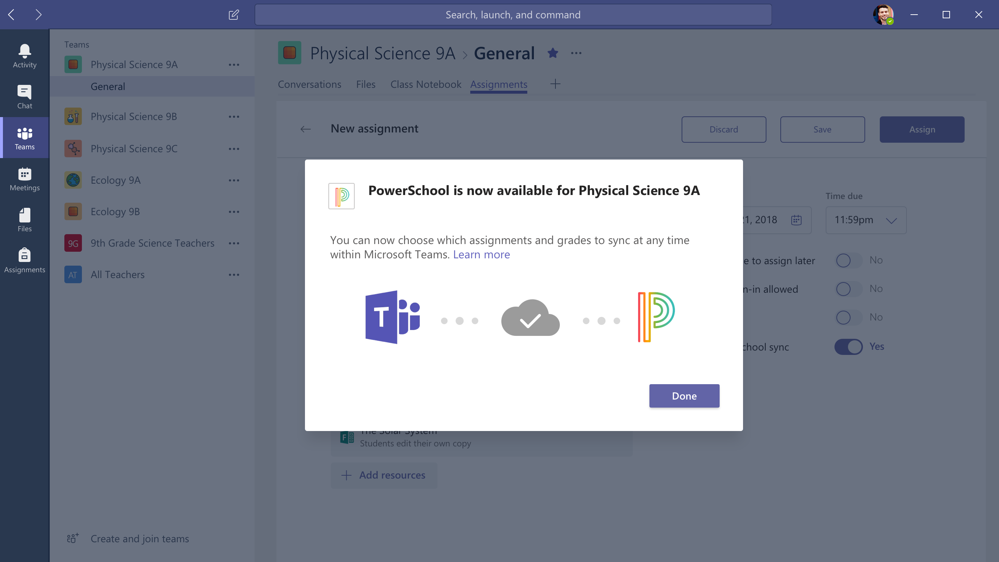
COMING SOON
Grade Writeback to SIS

Slide 21
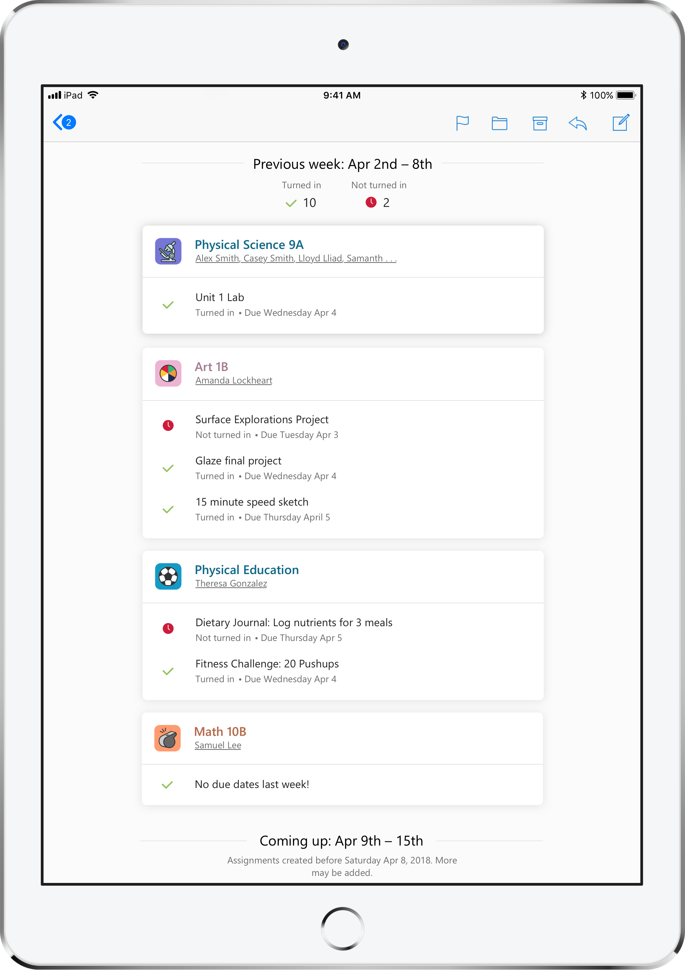
Teams Assignments and Parent Email Notifications

Slide 22
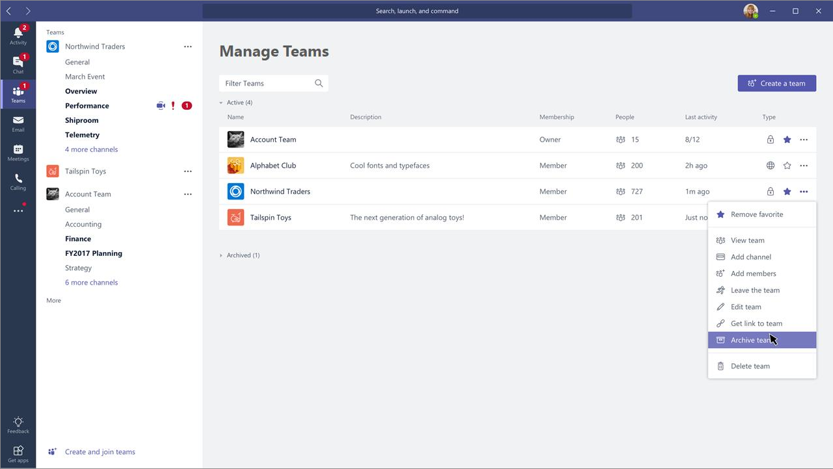
Archiving Teams

Slide 23
Reuse of Assignments
Reuse assignments from current or archived class teams.

Slide 24
Resources & Get Started

Slide 25
IT Pro Capabilities
Group / Team Naming Policy
Restrict students and faculty from creating Teams with arbitrary or inappropriate names
Group Naming Policy feature via PowerShell for AAD_BASIC_EDU customers is now available in Public Preview
aka.ms/GroupNamingPolicy
Group / Team Lifecycle Management
Automate lifecycle management – particularly expiry when students graduate, classes complete
Lifecycle Management tools via PowerShell
aka.ms/GroupExpiry
Automated Group / Team Provisioning
Automate creation of Teams before classes start
PowerShell command lets for Group / Team creation; only supports classic Team type (Class/Staff/PLC Team type coming soon)
aka.ms/Teams PowerShellCmdlets
Analytics / Reporting
Enhanced Team-level analytics and Admin reporting tools
We’re building this functionality now
aka.ms/TeamsBasicAnalytics

Slide 26
Microsoft Teams resources for Education admins
Customizable email templates and ready-to-print flyers and posters
Introducing Microsoft Teams for Education
VALUES
Introducing Microsoft Teams for Education
FEATURES
Empower with Microsoft Teams
VALUES
Empower with Microsoft Teams
FEATURES
The value of Microsoft Teams for Education
The features of Microsoft Teams for Education
aka.ms/AdoptTeamsEdu

Slide 27
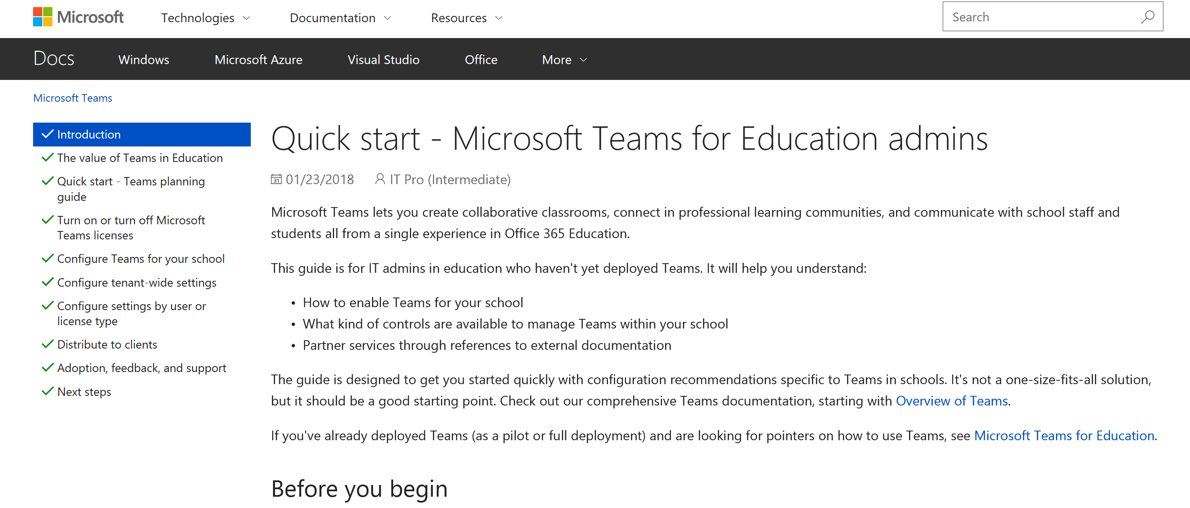
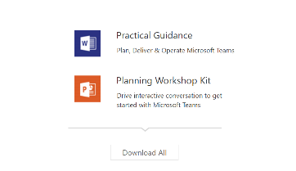
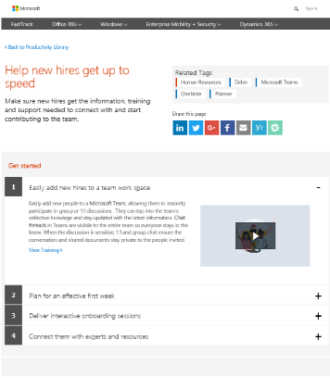
Resources to help your educators and staff get started
Success with Teams
www.successwithteams.com
Practical guidance
Plan-deliver-operate framework
Checklists, pre-reqs, adoption guides, tools
Office EDU Support
Support.office.com/education
Teacher friendly end user support
Videos, screen grabs, visual guidance
NEW! Student help center
Teams Edu Quick-start
Aka.ms/TeamsEduITGuide
IT and Tech specialist quick-start guide for getting Teams loaded for your school
Microsoft Education Community
Education.microsoft.com
Best practices from the educator community
Getting started guides on Teams based on user
Microsoft Innovative Educator training

Slide 28
Teams Deployment Best Practices
Pilot First
Start with internal IT pilot to test out Teams for everyday work
Get your team ready to support Teams
Identify faculty and student champions to pilot Teams
Deploy to all (or, phased if needed)
Once comfortable with Teams and pilot results, enable Teams access for Staff, Students, and Faculty
If needed, deploy first to Staff / Faculty, then Students; or by school / department
Marketing is Key
Let the University know about Microsoft Teams!
Utilize Marketing templates (banners, e-mail)
Assess and provide feedback
Observe where Teams satisfies your requirements and where it does not
Send us feedback in-product / User Voice

Slide 29
Roadmap Resources https://www.microsoft.com/en-us/videoplayer/embed/RWlZqk?autoplay=true https://www.microsoft.com/en-us/microsoft-365/roadmap?filters=Education

